Slide 1
EE 175AB Senior Design · ENGR 181W Technical Communication
Battery Management System
Custom Designed
10-cell lithium-ion pack Battery Management System PCB
Electronic Load PCB
Compatible User Interface
Kaushik Vada · Nicholas Poon · Christian Kim
University of California, Riverside · Department of Electrical Engineering · June 1, 2026
Project team also includes alumni and former team member Connor Stewart (architecture & BMS schematic). Advised by Dr. Roman Chomko.
Notes:
[Kaushik, 10s] Welcome — we're presenting the Battery Management System we built for EE 175AB. It's a 10-cell lithium-ion pack with a programmable electronic load and a PyQt6 desktop dashboard. I'll cover the problem, Nick will walk through hardware, Christian will cover the E-Load and our validation, and I'll close with results and future work. Connor Stewart was our fourth team member but is not presenting today.

Slide 2
Introduction & Motivation
The Problem
Lithium-ion cells without protection risk thermal runaway — a serious safety hazard
A Battery Management System (BMS) is essential in nearly every rechargeable device
Our Goal
Design and build a custom BMS to understand battery systems firsthand
Sharpen our PCB design skills and learn BMS architecture end-to-end

Slide 3
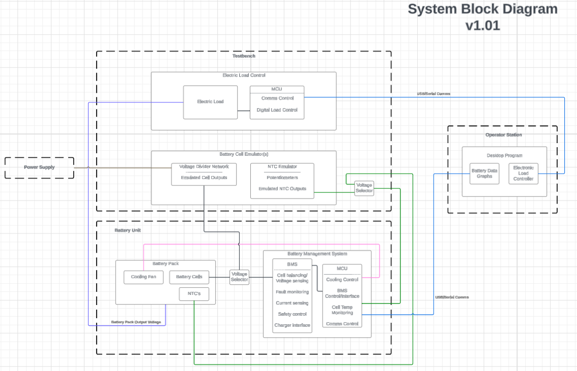
System Overview
We designed and manufactured three custom PCBs that work together:
BMS — the core board: monitoring, safety logic, and telemetry
Eload — a test bench to safely exercise the BMS safety behavior
Cell Emulator — emulates battery cells for controlled testing

Slide 4
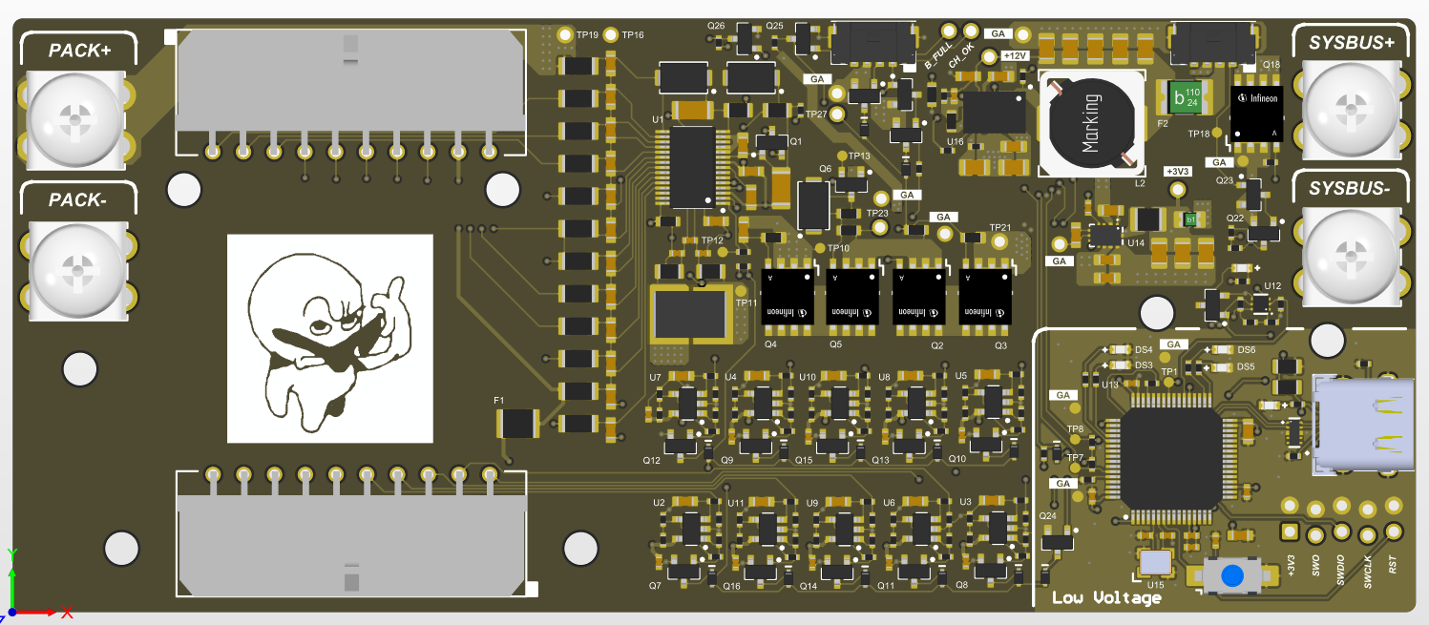
The BMS Board
1
Cell monitoring
Voltage & current per cell
2
Thermal control
Thermistors drive cooling fan
36 V / 4 A nominal · built around the BQ76930 BMS IC
3
Hardware safety
Relay isolates pack on fault
4
Telemetry
Live data to host over USB (STM32)
Custom BMS main board · designed & manufactured in Altium
5
Fault detection
Continuous fault-status tracking

Slide 5
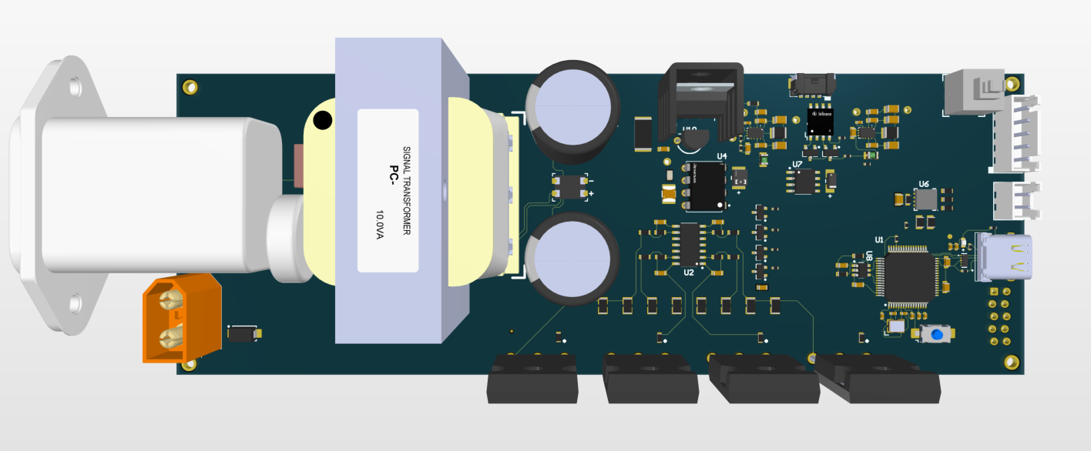
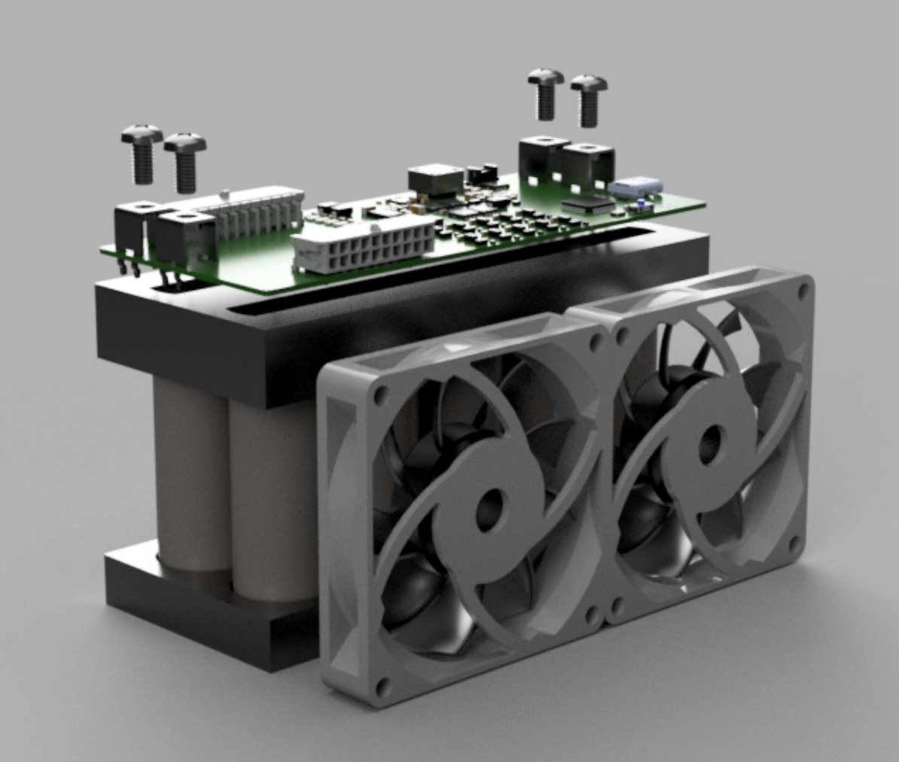
Eload — Test Bench
A self-contained electronic load that safely draws controlled current to exercise the BMS.
1
Current sink
Four power MOSFETs sink the load current through precision shunts.
3
Connect & cool
Battery via XT60, host via USB-C; a PWM fan cools the MOSFETs.
2
Set & measure
A DAC sets the current; the STM32 reads the shunts for accurate V & I.
Eload board — Altium-designed
Cooling fan

Slide 6
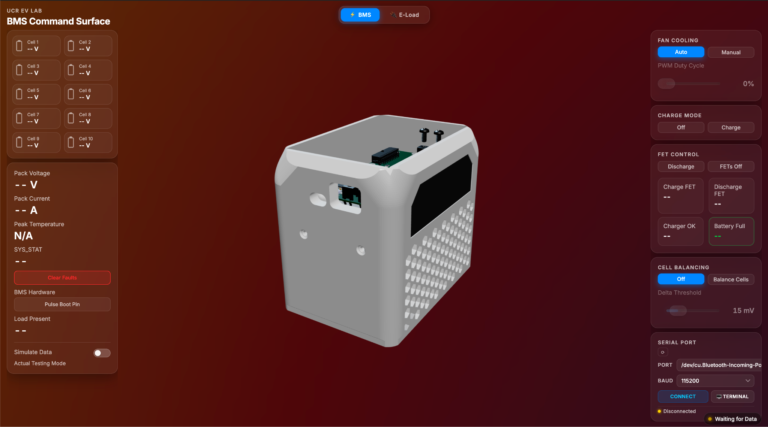
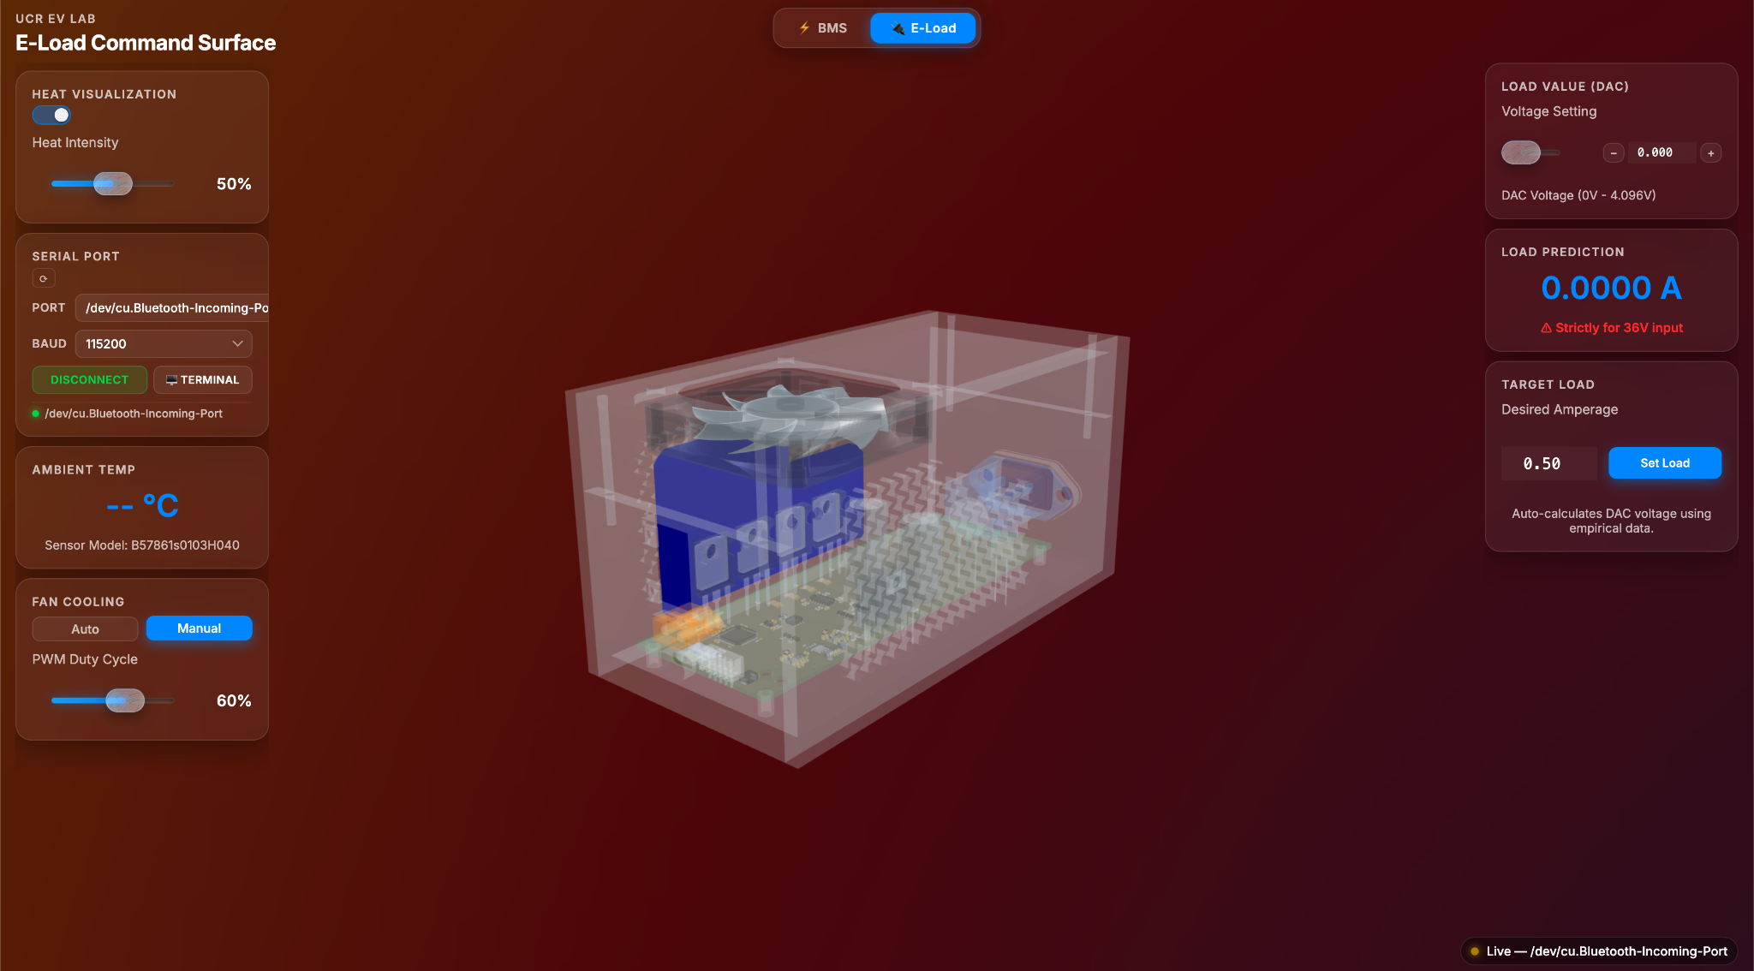
GUI & Telemetry
Live telemetry
Real-time streaming of cell voltage, pack current, and thermal sensor data.
Python host control · USB CDC · live monitoring
Fault status
Surfaces active hardware faults, safety states, and BQ76930 register alerts.
Full size on slides 8–9
Command surface
Bi-directional control link for FET states, fan PWM, and calibration commands.
Command surface

Slide 7
Conclusion
Future work
1
Full-stack senior design works.
BMS
Custom PCBs, custom firmware, custom desktop app — all integrated, all observable from one dashboard.
Integrate the relay onto the PCB · USB isolation between BMS and E-Load · backup over-temperature comparator · charger harness redesign.
2
Safety is hardware-enforced.
E-Load
BQ76930 + electromechanical relay isolate the pack on fault regardless of firmware state; GND-ALWAYS-ON keeps diagnostics alive.
Scale beyond 1 A · proper op-amp feedback filtering · correct shunt selection · constant-power and constant-resistance modes.
3
Real compute workload validated.
Dashboard
The pack powered an NVIDIA Jetson Orin Nano running a 1.3 B-parameter AI model end-to-end without tripping protection.
Hardware-in-the-loop replay mode from stored telemetry · bidirectional USB hot-plug · LCD module for headless monitoring.
Battery Management System · EE 175AB / ENGR 181W 8 / 9
Notes:
[Kaushik, 45s] To wrap up: we built a complete senior-design BMS with custom hardware, custom firmware, and a custom desktop dashboard, and we got all three layers to talk to each other reliably. Safety is hardware-enforced — the BQ76930 and the relay can isolate the pack without any firmware involvement. And we proved the system is solid enough to power a real compute workload: an NVIDIA Jetson Orin Nano running a 1.3 billion parameter AI model. Future work is straightforward: redesign the breaker as an integrated relay on the board, scale the E-Load past one amp, and add a hardware-in-the-loop replay mode to the dashboard. Thank you — we'd be glad to take questions.

Slide 8
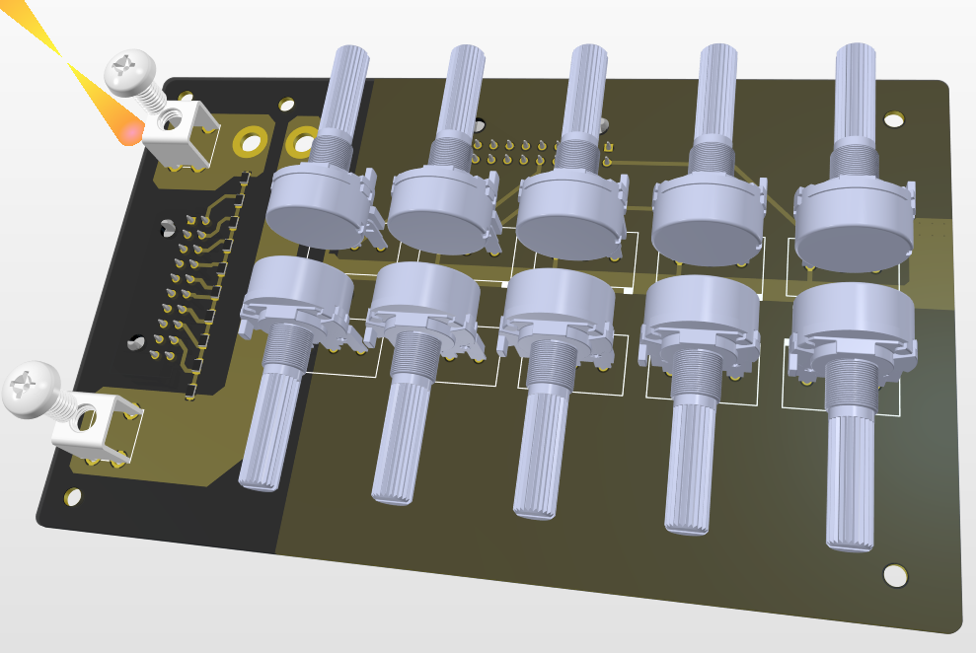
Placeholder rn for images copy n paste accordingly to their slide page

Slide 9
Speaker Notes (hidden — not shown in presentation)
Delivery / timing cues (parked from slide faces)
Intro & Motivation: Nick — ~1 min
System Overview: ~20 sec
Keep transitions tight; hand off cleanly between presenters
Reminders to self
Don't use unnecessary technical terms
Avoid small text — don't just read the lecture slides
Show images of the GUI together with the BMS
Describe each part, then present results at the end

